Slide 1
Movie Recommendation System
21500095 Sion Kim
21500643 Sunil Jeong
21600752 JaeKyung Ha
21700034 YeongHye Kwak

Slide 2
Contents
Background
Problem Specification
Approach
Summary & Broad Impact
Demo
Contribution

Slide 3
Background
What is the Movie Industry Trends in Korea?
300 films EVERY YEAR
400 million viewers in 2019
What is the currently running Service that satisfy the need?
Naver films
Notes:
About 300 films are made every year in Korea, and the number of viewers reached about 200 million just in the first half of 2019.
Naver movies has been providing movie-related services for its users with a web application named “Naver films”
The ratings and comments of Naver Films’s most of the review are by ordinary netizens or visitors.

Slide 4
Problem Specification
Naver films service does not seem to satisfy the needs of the users!
1
Too much focus on Korean films
what about foreign films?
2
Lack of expert reviews
need more reliable data
3
Need for recommendation system just for you
Notes:
Naver films have too much focus on Korean films.
As a result, it is difficult for users who are interested in overseas films to receive satisfactory services.
The ratings and comments of Naver films lack expert reviews.
As a result, users, who refer to those comments when selecting a movie to watch, often feel dissatisfied with the choices.
There are movie recommendation applications tailored to the real-time ranking of the movie and the cumulative number of viewers, but there are not many objective movie recommendation applications tailored to other needs.

Slide 5
Approach
Database & Web Application

Slide 6




AWS Server Connect(Database+PHP)
Notes:
We built a server using AWS EC2.
And we created myysql database on that server and connected php so that the web and database could interact.

Slide 7
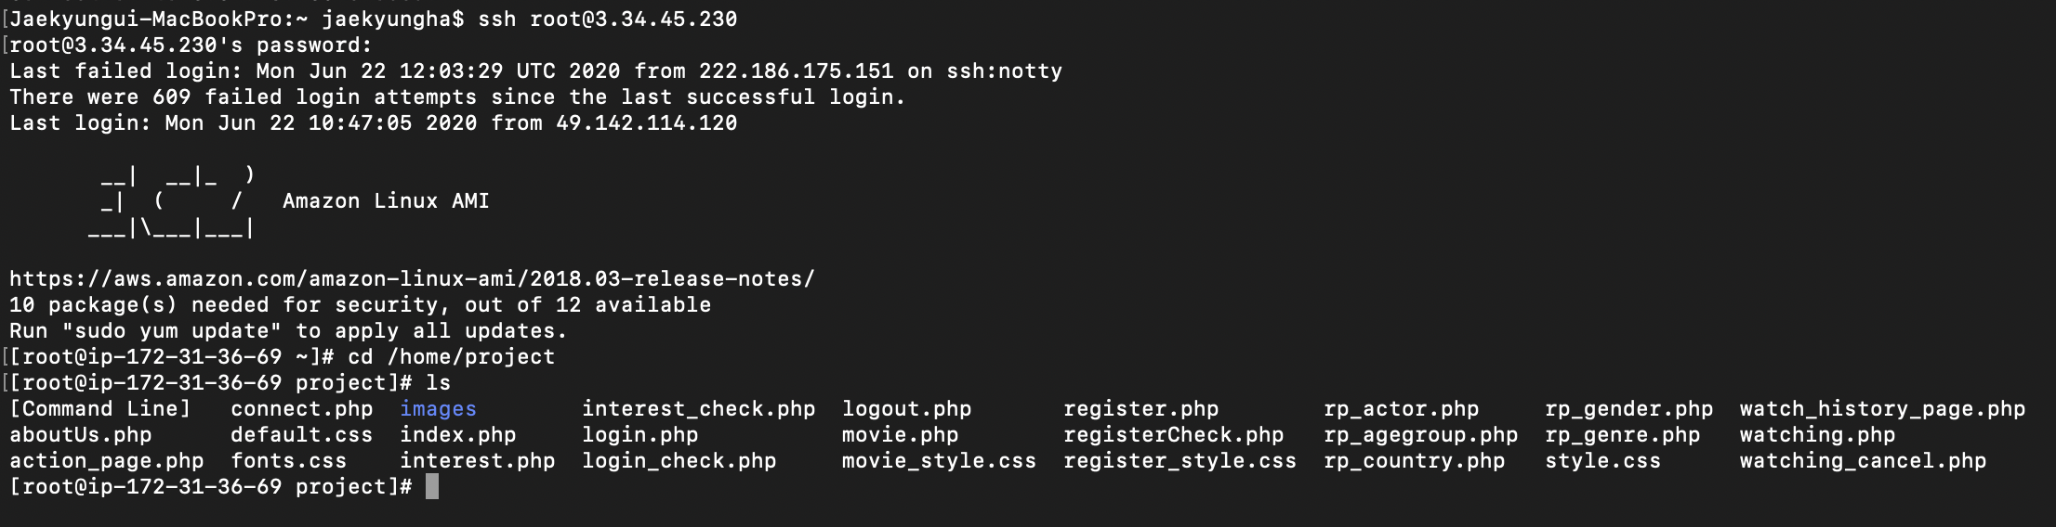
AWS Server Connect(Database+PHP)
Notes:
We connected the deployed server to a Linux instance using SSH.
Through the image on the screen, you can see the connection to the server using ssh.

Slide 8
Database Design
Tables & Attributes

Slide 9
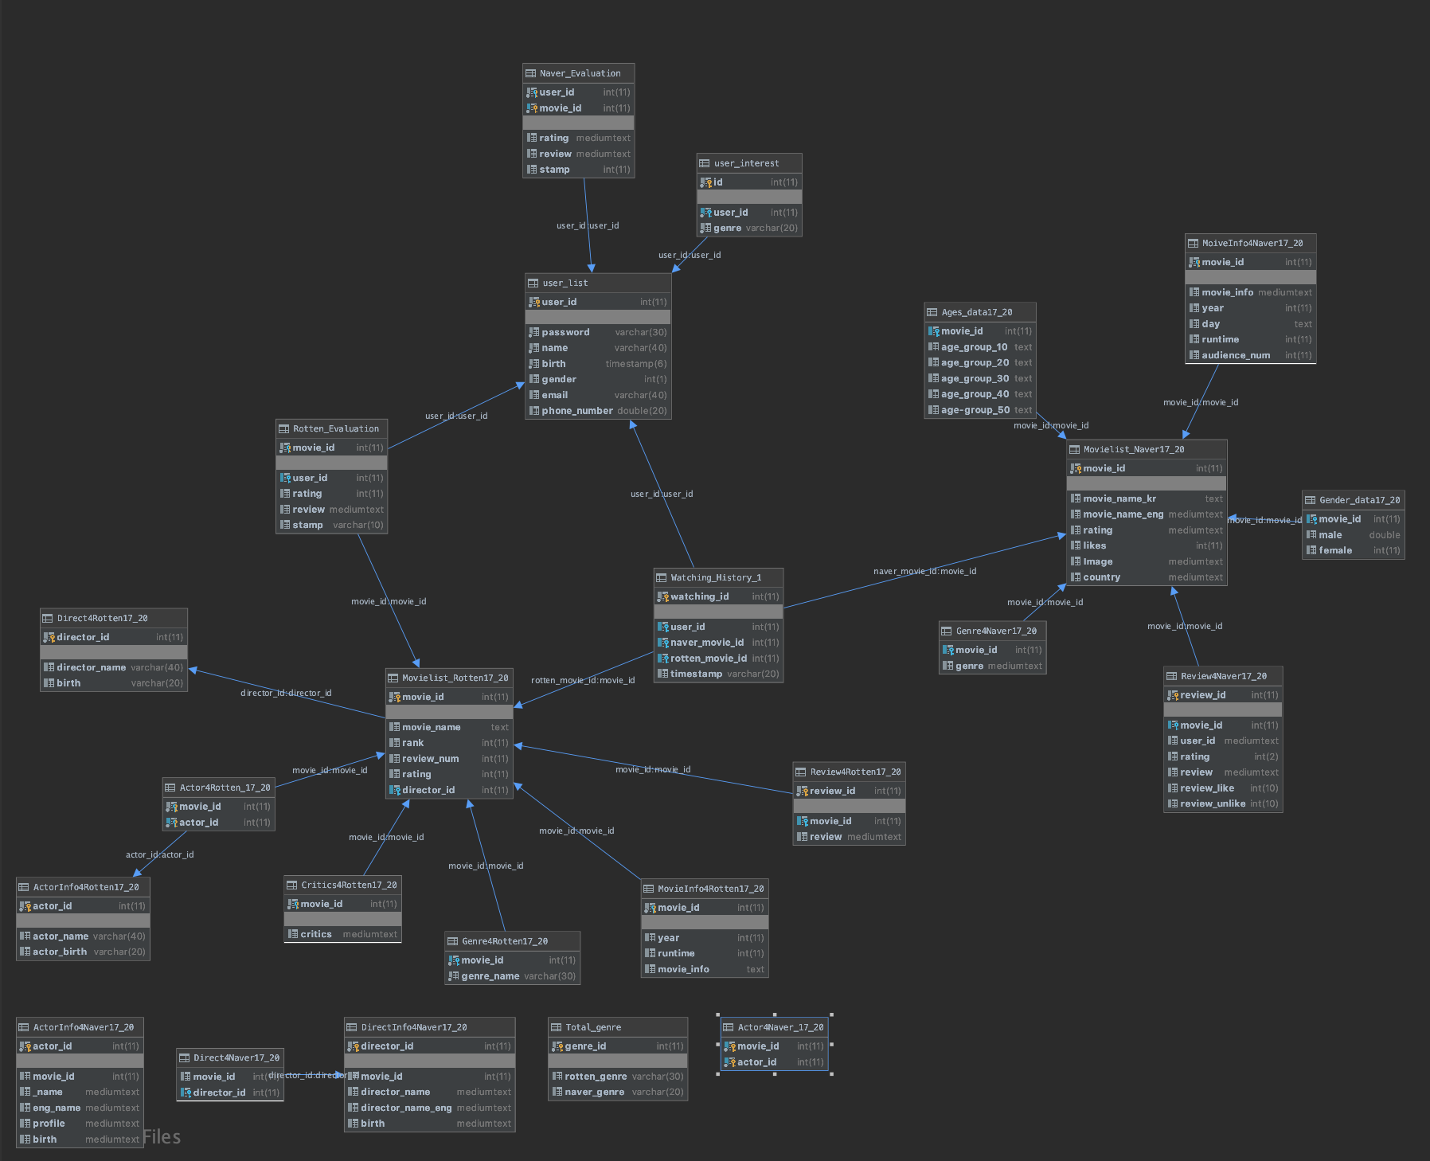
Notes:
This is the Our overall database scheme
Let’s take a detail.

Slide 10
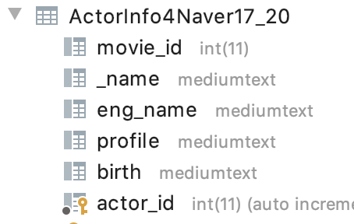
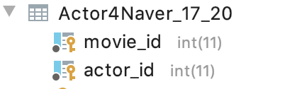
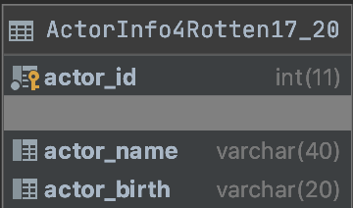
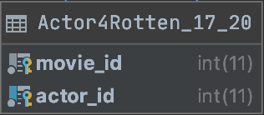
Actor Tables
Notes:
ActorInfo Table has actor information.
and Actor Table has information about which actor appeared in the movie.

Slide 11
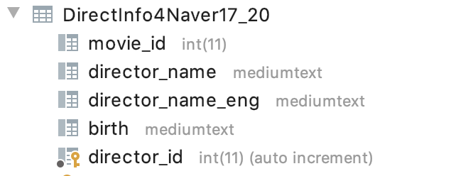
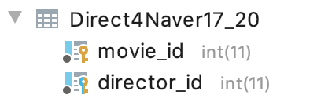
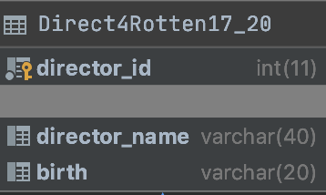
Director Tables
Notes:
DirectorInfo Table has director information.
and Director Table has information about which director made the movie.

Slide 12
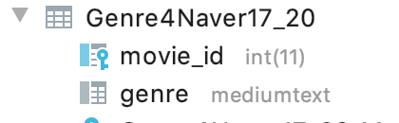
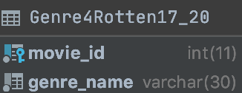
Genre Tables
Notes:
Genre Table has information about genre

Slide 13
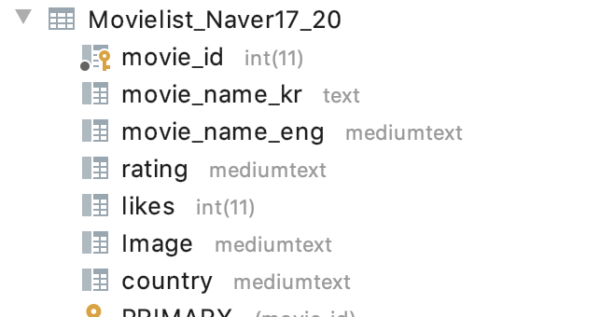
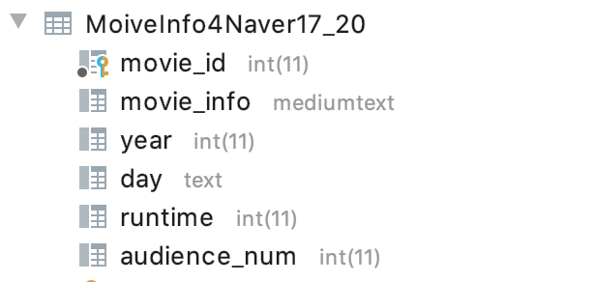
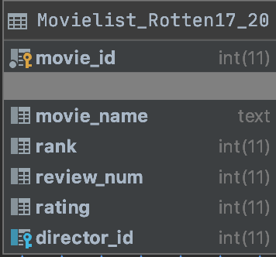
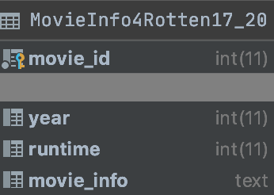
Movie Information Tables
Notes:
Movielist table has list of moives information and MovieInfo table has information of each.

Slide 14
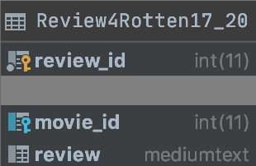
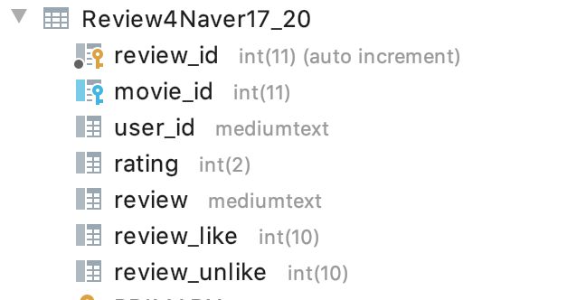
Review Tables

Slide 15
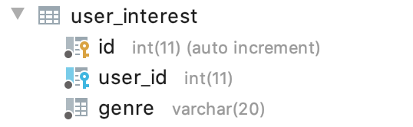
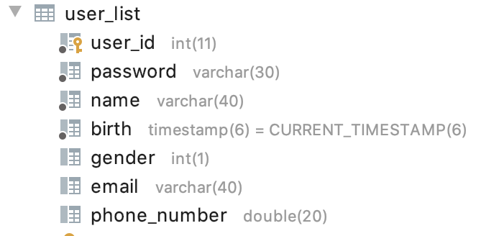
User Tables
Notes:
user_list has Information about users registered on our homepage
User_inserrest has interest of user

Slide 16
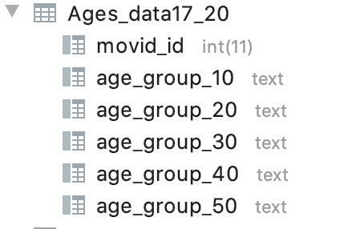
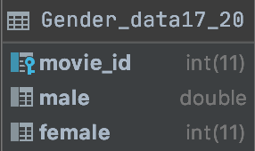
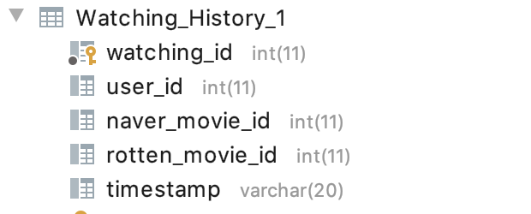
More Tables Used For Recommendation
Notes:
We use Age data and Gender data Watching data for Recommendation

Slide 17
Application Design
Pages & Recommendation System

Slide 18
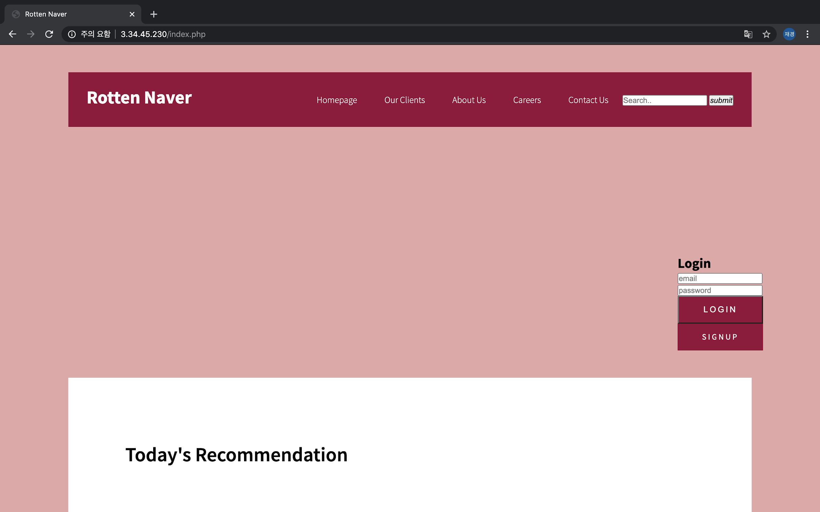
Application Design
Web Page - Rotten Naver
Search Function
Search Naver and Rotten Tomato by title
Login Function
Using email and password
Sign-Up Function
Using name, email, password, gender, phone number, and birth.

Slide 19
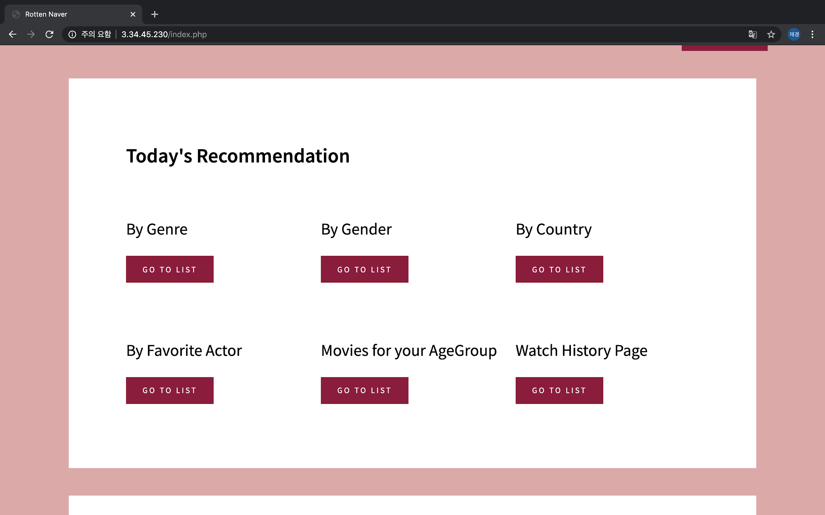
Recommendation System
By Genre
Movies of similar genres
By Gender
Movies preferred by the user’s gender
By Country
Movies made from country that user usually watches
By Actor
Movies acted by an actor that user usually watches
By AgeGroup
Movies that user’s age group prefers
Notes:
Rotten and Naver ratings by averaging them.
through interest genres and movie viewing lists.
Identify the country of movies that users have watched a lot and recommend movies from that country.
Identify the actors who have watched many movies and recommend them.
Compute user age and recommend movies that age prefers.

Slide 20
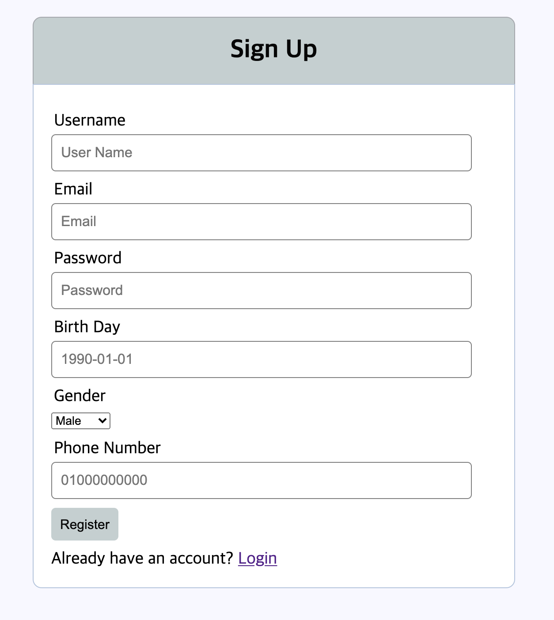
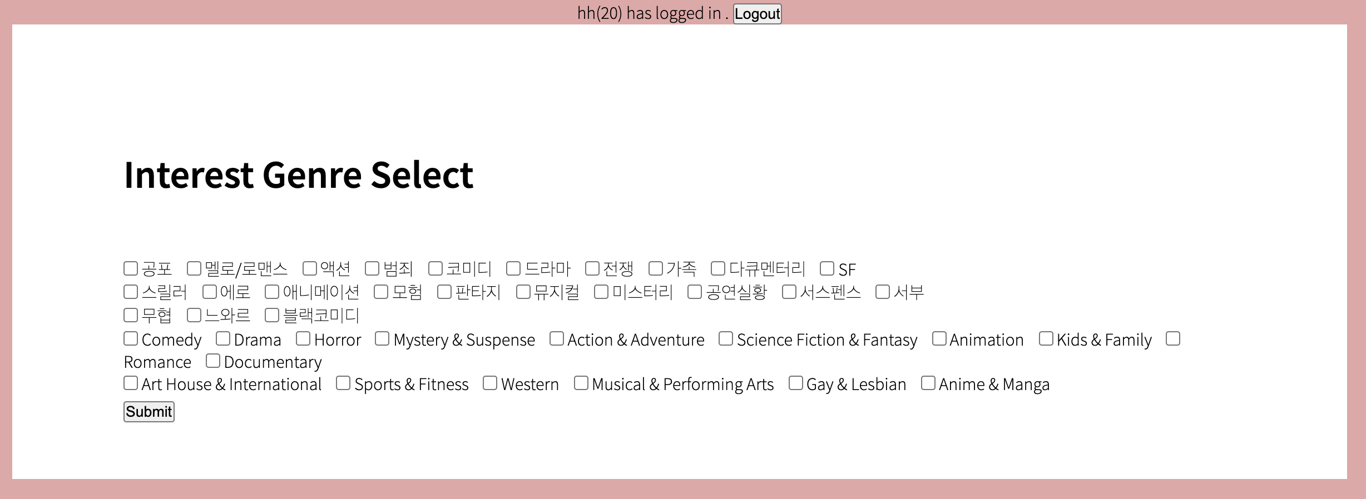
Sign Up & Interest Selection
When logging in for the first time after signing up as a member, let users choose their favorite genres.

Slide 21
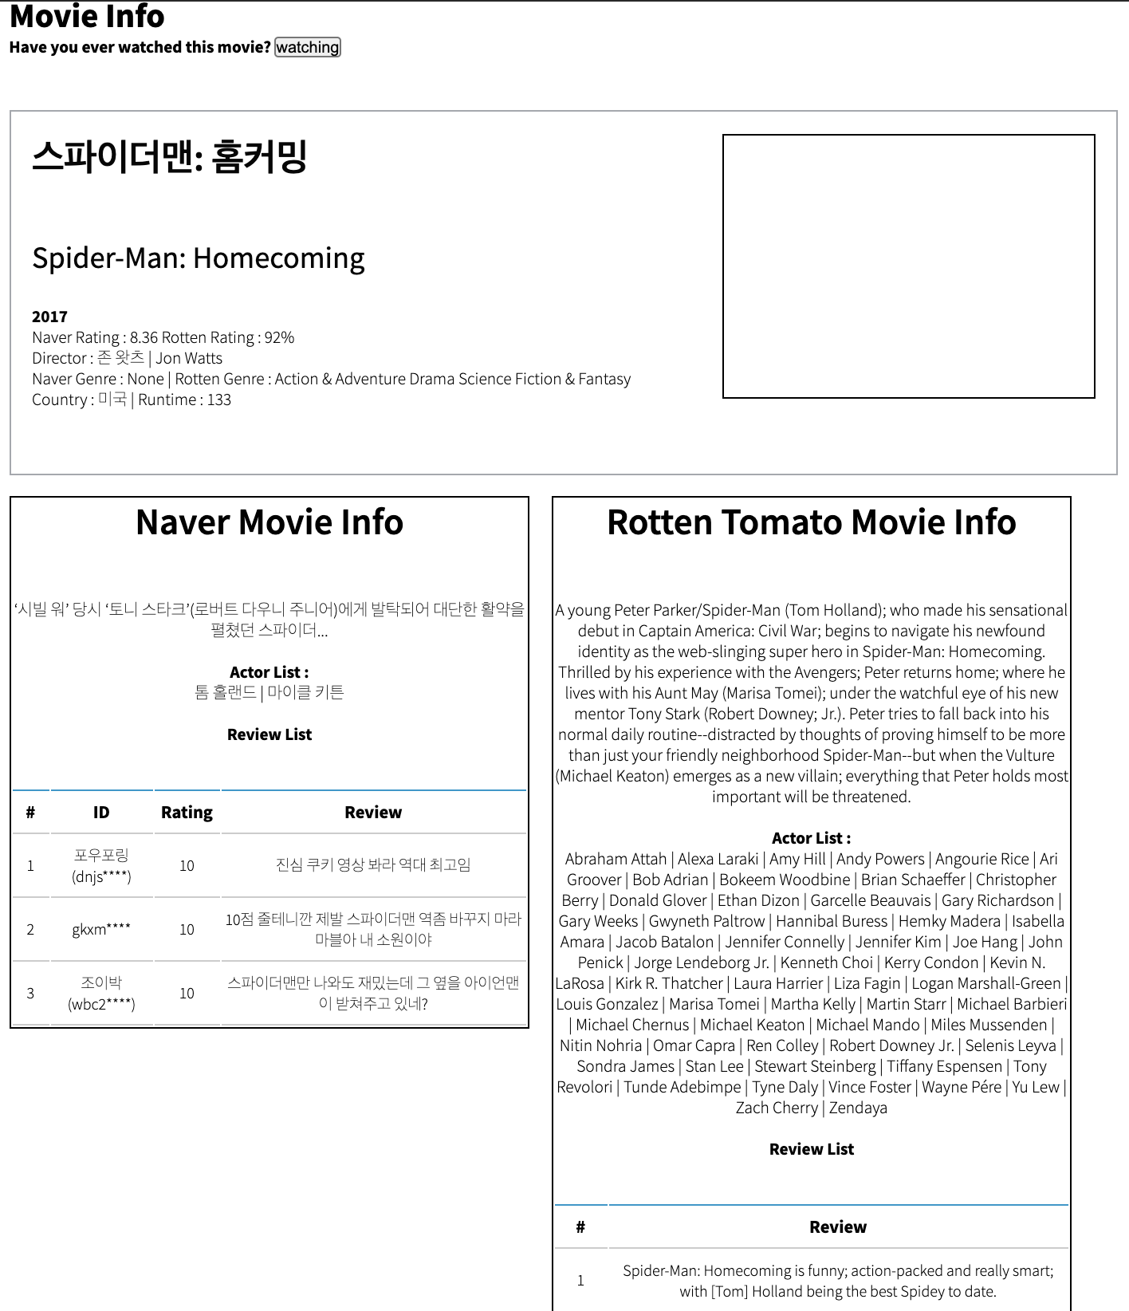
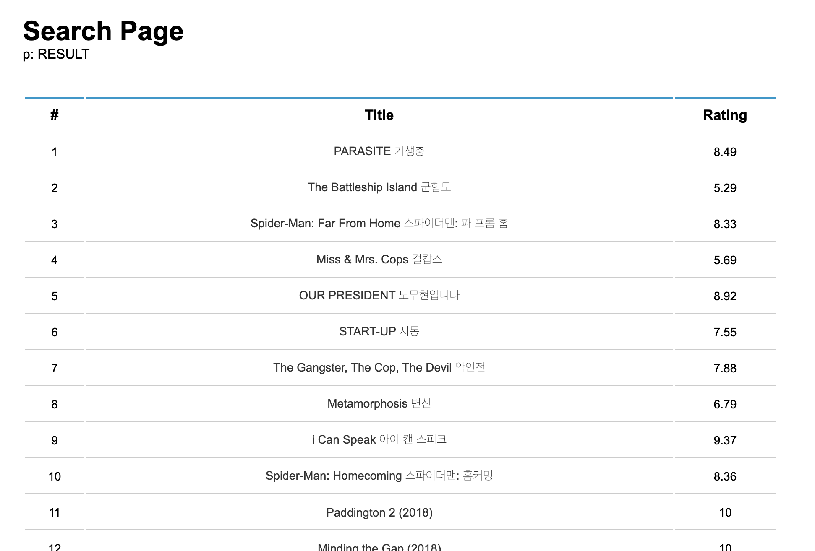
Detail Page
Users can check movie details when they choose a movie from the movie list. It allows user to check both Rotten and Naver information.

Slide 22
Summary
Problem
Lack of services that provide by Naver films
Approach
Build a database using movie data from Rotten Tomato and Naver movies
Developed a website that recommends movies creatively and diversely
Outcome
Rotten Naver (WebPage)
Information about Domestic & Foreign movies
Tailored Recommendation System
Notes:
As for the summary,
Firstly for the problem, Naver films does not provide enough diverse services that consumers are asking for
To address this problem, we decided to add Rotten tomatoes data to the data provided by Naver films.
Using the built database, we were also looking to provide new recommendation system that recommends movies in diverse ways.
As for outcome
we have created a Webpage named Rotten Naver, in this webpage users will be able to gain information about domestic and foreign movies and experience tailored recommendation system that would find right movies for them.

Slide 23
Broad Impact
Decrease the dissatisfaction
4
Various Contents
This application can be widened in range of combined databases to provide huge pool of movie information world-wide.
With more satisfaction, there can be another boom in the movie industry
1
3
International promotional effects
Export domestic films abroad
Movies including none-mainstream movies can be widely promoted.
Foreign film distributors can import and see the potential for the success of the film.
2
Notes:
Now for the Broad impact
First expect that this application will decrease the dissatisfaction of the domestic users which make more consumers be interested in movies. This will definitely bring good economic impact in the movie industry of Korea.
Secondly, by recommending diverse movies that fit the user’s taste, the movies that are not part of mainstream can be recommended to users. For those movies, these little exposure to consumers can be very helpful.
Thirdly, providing services both in Korean and English, if this webpage is used by not only domestic users but also foreigners, then this will mean our domestically made films get chance to be exported abroad. This can lead to many other positive possibilities for Korean movie makers.
Lastly, if this webpage gets successful enough, it will not just stop at this service and add more databases to this application so that it can eventually become the large data pool about whole movie industry of the world. If this happens, then better services using big data are possible

Slide 24
Demo
Demo video link:
https://www.youtube.com/watch?v=TVg_lt6vyms

Slide 25
Contribution
Points Scored
YeongHye Kwak(DB)
Sunil Jung(DB)
25.0%
25.0%
Sion Kim(PHP)
JaeKyung Ha(PHP)
25.0%
25.0%

Slide 26
WebPage Address
Type: 3.34.45.230
on Address Bar of Chrome

Slide 27
Thank You!
Database System(2020-1)

